Slide 1
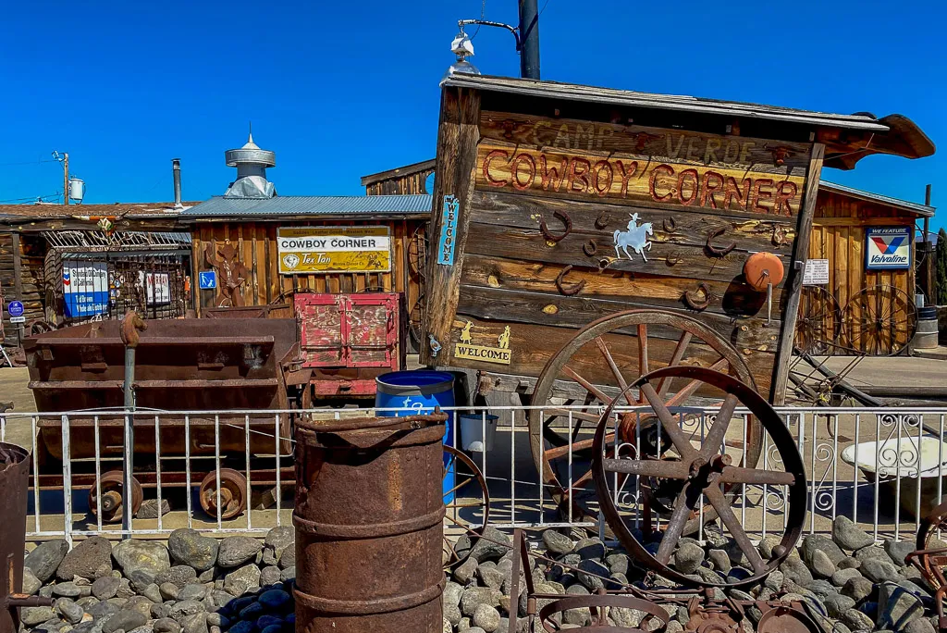
VISION 2050 GENERAL PLAN
TECHNICAL Advisory group meeting – August 13, 2024

Slide 2
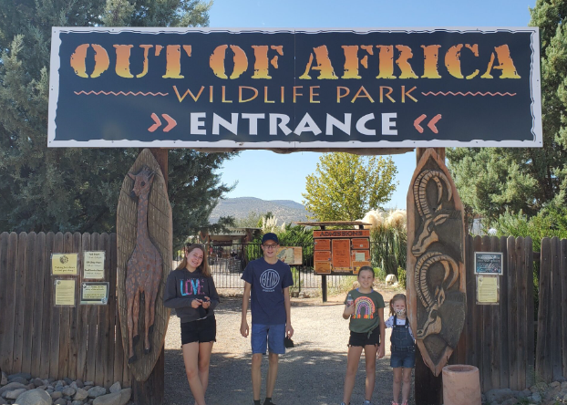
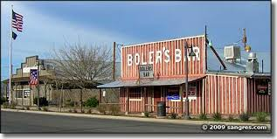
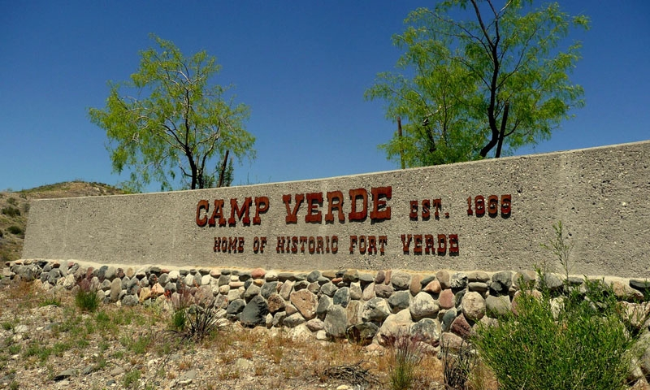
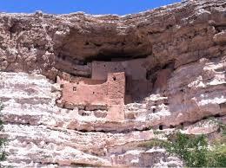
Vision 2050 – Introduction
The Town of Camp Verde is preparing an initial draft of the Vision 2050 General Plan rewrite update:
Adopt every 10 years
TAG Members
Roles and Responsibilities (presentation by Town Manager, Miranda Fisher
TAG Meetings Scheduling
Discussion of Town’s draft Vision Statement
Overview
TAG Role, Members and Responsibilities
What the General Plan is
Town’s Vision Statement

Slide 3
Vision 2050 – Technical advisory group members
Group Members:
Staff Members:
Marie Moore, Vice Mayor
Bill Tippett, Planning & Zoning Commissioner
Todd Scantlebury, Planning & Zoning Commissioner
Dave Grondin, Parks & Recreation Commissioner
Cris McPhail, Community Member-at-Large, Council Member
Wendy Escoffier, Community Member-at-Large, Council Member
Tanner Bryson, Community Member-at-Large
Tony Gioia, Community Member-at-Large
Ed Mazulis, Community Member-at-Large
Miranda Fisher - Town Manager
John Knight - Community Development
Cory Mulcaire - Community Development
Molly Davies - Economic Development
Jeff Low - Utilities
Ken Krebbs - Public Works
Jason Sanks - General Plan Consultant

Slide 4
Vision 2050 – what is a general plan?
What it is:
What it is not:
A tool for education and communication
More than a land use map
An expression of participating citizens' preferences
A statement of Town growth management policy
A guide to public and private decision making
A long-term perspective for municipal progress
A blueprint to improve residents’ quality of life
A legal requirement under Arizona State Law
Complements other plans, i.e. Town’s Strategic Plan, Water Master Plan
____________________________________________________________
A zoning map, although it sets general land use parameters
Not a regulatory document like a zoning or building code
A tool to promote special interests
An unchangeable document
A detailed policy for specific properties or areas
A capital improvement program
A Town Budget

Slide 5
Vision 2050 – Review of general plan components, New Structure:
Introduction
Current General Plan is comprised of eleven (11) Chapters and has a total page count of 182 pages. The Vision 2050 General Plan will propose four (4) main chapters entailing the following subsections:
Establishes the goals of the General Plan.
Examines the history and cultural themes
Amendments and Process
Explains the process of making amendments to the General Plan as well as zoning ordinances
Elements
Community Character (new)
Land Use
Character Areas
Circulation, Trails & Transportation
Open Space & Recreation
Growth Area & Economic Development
Housing
Environmental Planning
Water Resources
Cost of Development
IMPLEMENTATION AND Action STRATEGIES
Describes the Implementation and Action Strategies to see how the Town’s Goals and Objectives can be met

Slide 6
Vision 2050 – town vision statement
Regional Context
History/Arts/Culture
Vision for Growth
Economic Development
Housing
Transportation
Lifestyle/Recreation
Conservation
VISION
STATEMENT
COMPONENTS:

Slide 7
Vision 2050 – town vision statement (new draft)
“The Town of Camp Verde is dedicated to preserving its rural, friendly, and historic atmosphere while embracing growth that aligns with its natural scenic beauty and cultural heritage. Our vision is to foster a sustainable community that offers local shopping, employment, and diverse housing opportunities while preserving the Town’s natural resources, including the Verde River, its tributaries, and open space areas. As we welcome new businesses and support existing ones, we encourage development that is well-balanced, visually appealing, and respectful of our environment and collective cultural identity.
The Town continues to value its rich history, arts, and agrarian heritage while providing an exceptional quality of life. We value preserving our environmental quality by considering the impacts of new development while promoting practices that ensure a healthy community. Our commitment to a sustainable water supply, safe and efficient transportation systems, and natural open space reflects our dedication to the long-term well-being of our Town. Through careful, responsible development choices we seek balance between growth and preservation, ensuring Camp Verde will be a unique and vibrant community for generations to come."

