Slide 1
CAMP VERDE PUBLIC SAFETY ASSOCIATION
NOTHING WORTH HAVING WAS EVER ACHIEVED WITHOUT EFFORT.
-Theodore Roosevelt

Slide 2
Introduction
We are the Camp Verde Public Safety Association
A Chapter of the Arizona Conference of Police and Sheriffs.
Our Chapter was established in 2004 and is currently holding strong with 26 members.
Our mission is to enter into negotiations with the Town of Camp Verde during the Fiscal Year 2021/2022 budget session.
Our Executive Board is representing the findings of it’s members research of wage and benefit comparisons to the surrounding agencies.
We want to work in unison the Department Head and the Town Manager for the benefit of the its employees and union members.
The following presentation uses the data derived from the research by CVPSA members, the Town of Camp Verde Salary Study (purchased from the City of Cottonwood) and the current Town of Camp Verde wage scale..

Slide 3
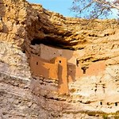
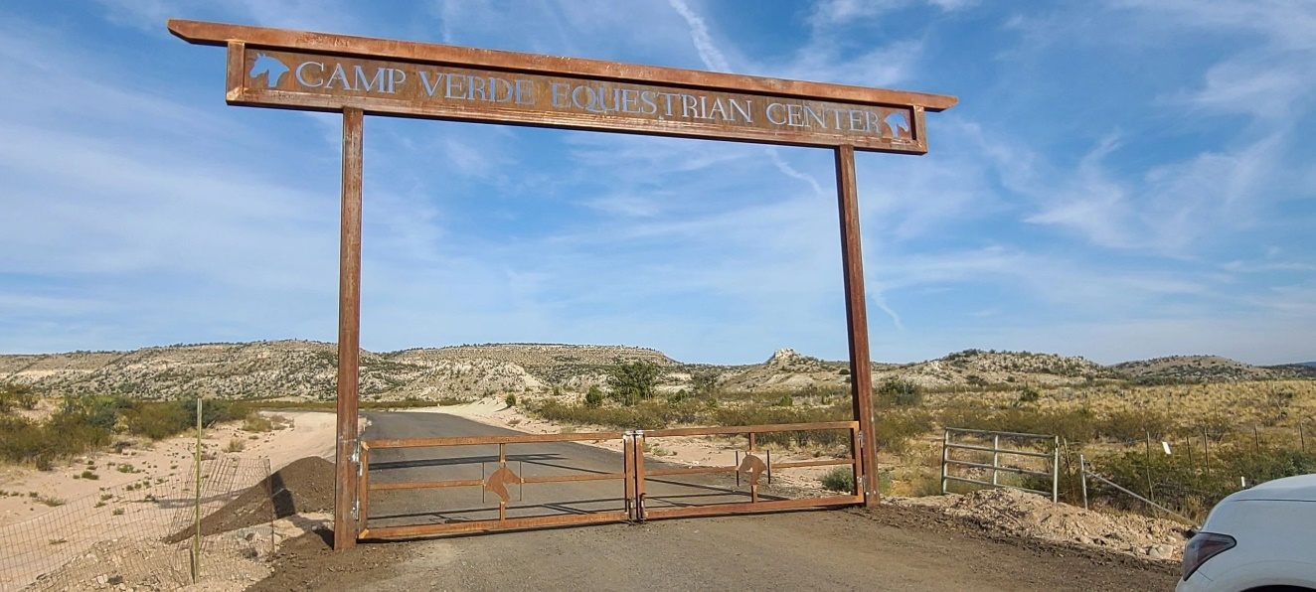
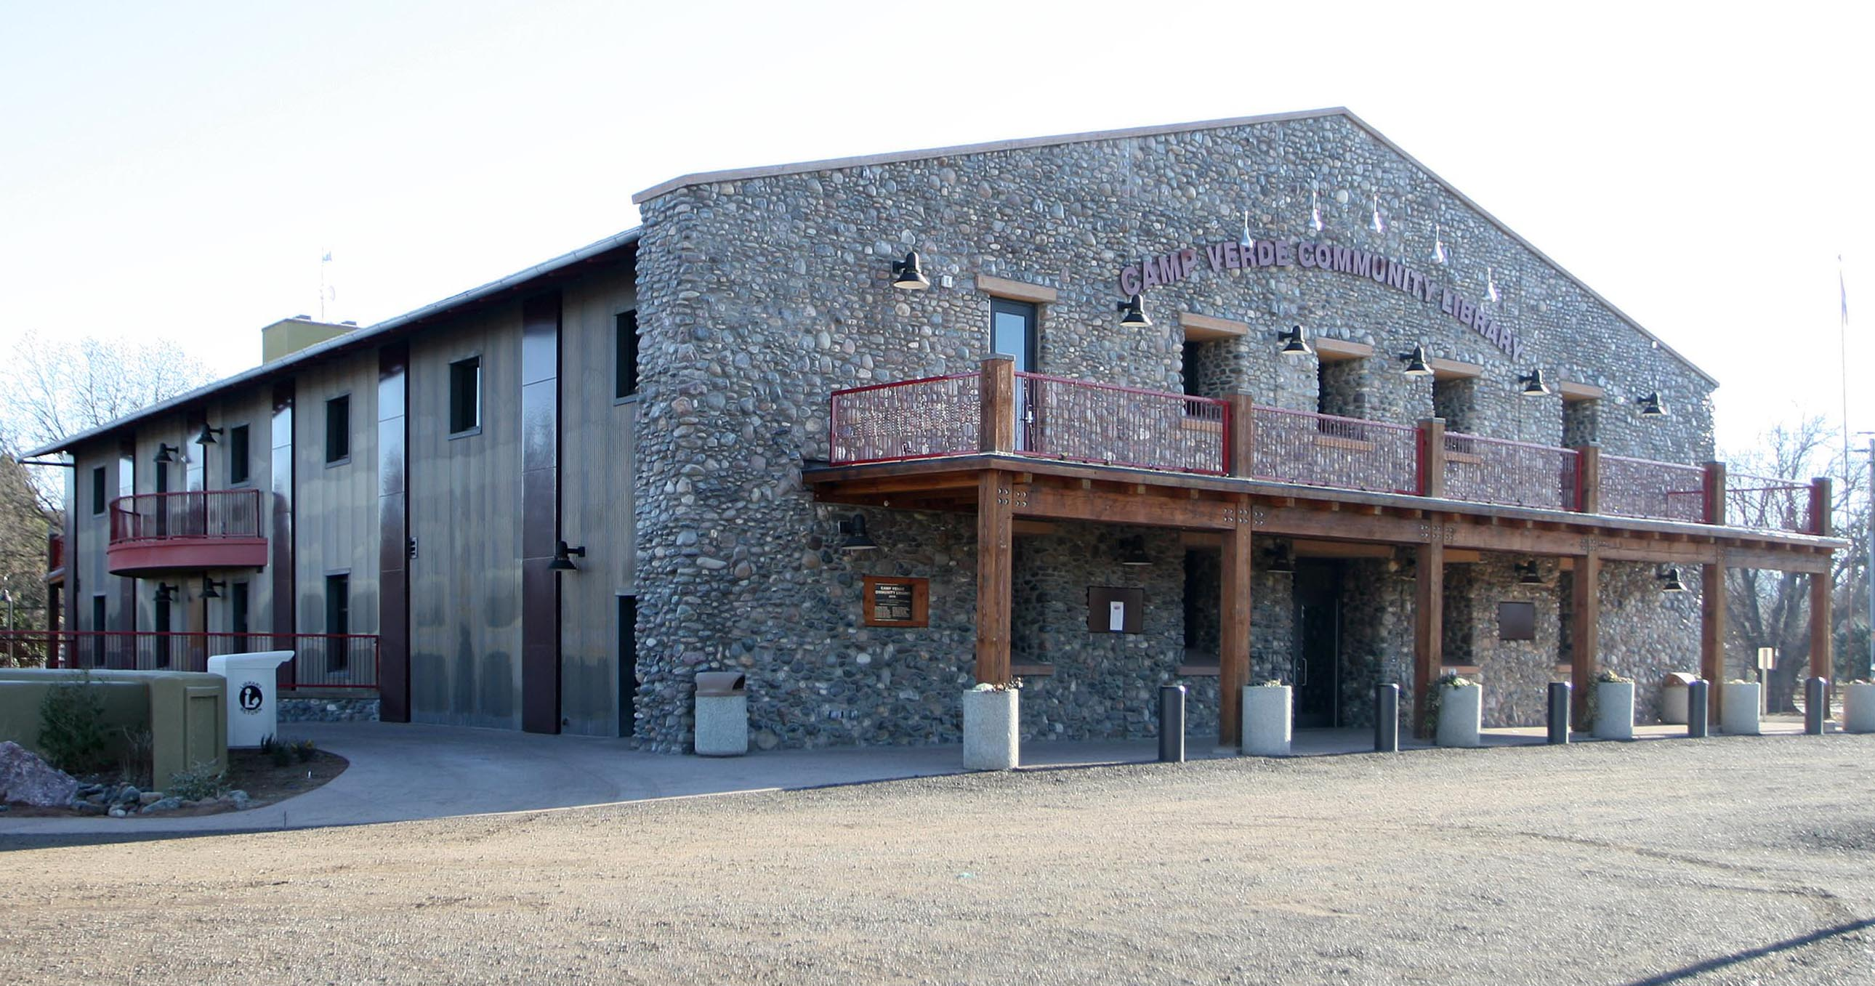
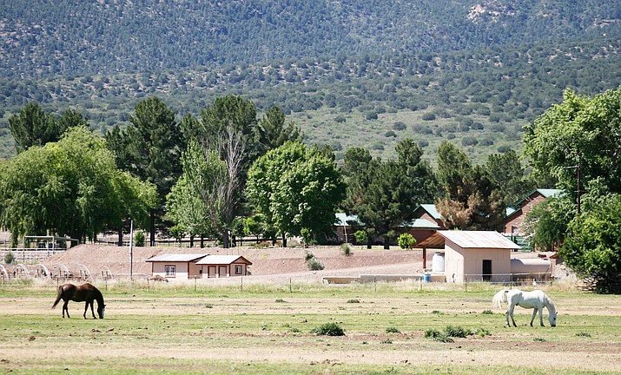
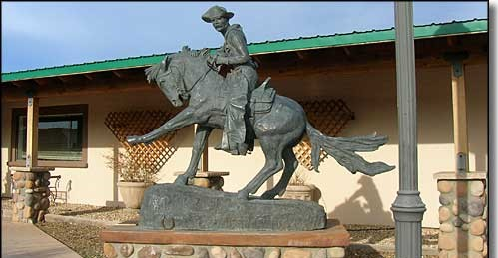
Our Town

Slide 4
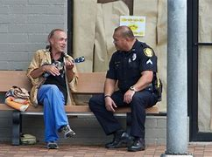
WHAT’S YOUR NEIGHBOR INVESTING IN THEIR PUBLIC SAFETY?
Current Camp Verde Marshal’s Office Deputy Pay Scale:
$22.20 To $32.19 Hourly
$46,183.56 To $66,967.08 Yearly
Yavapai County Sheriff’s Office:
$24.28 To $36.51 Hourly
$50,502.40 To $75,942 Yearly
Cottonwood Police Department:
$23.89 To $35.22 Hourly
$49, 708.95 To $73,253.65 Yearly
Sedona Police Department:
$24.39 To $35.18 Hourly
$50,731.20 To 73,174.40 Yearly
Arizona Department of Public Safety:
$24.85 To $34.81 Hourly
$51,685.92 To 72,413.12 Yearly
Prescott Valley Police Department:
$25.91 To $36.26 Hourly
$51,563.20 To $75,420.80 Yearly

Slide 5
WHAT’S YOUR NEIGHBOR INVESTING IN THEIR PUBLIC SAFETY?
Current Camp Verde Marshal’s Office Dispatcher Pay Scale:
$17.08 To $24.77 Hourly
$35,532.72 To $51,522.24 Yearly
Yavapai County Sheriff’s Office:
$18.12 To $22.11 Hourly
$37,689.60 To $45,988.80 Yearly
Cottonwood Police Department:
$19.66 To $28.97 Hourly
$40,892.80 To $60,257.60 Yearly
Sedona Police Department:
$19.11 To $27.55 Hourly
$39,748.80 To $57,304.00 Yearly
Arizona Department of Public Safety:
$19.12 To $25.20 Hourly
$39,769.60 To $52,416.00 Yearly
Prescott Police Department:
$19.60 To $31.00 Hourly
$40,768.00 To $64,480 Yearly

Slide 6
TOWN OF CAMP VERDE CURRENT PAY SCALE
Current Patrol Starting $22.20 Mid $27.20 Max $32.20
2.5% Increment | $ 22.20 | $ 22.76 | $ 23.32 | $ 23.91 | $ 24.50 | $ 25.12 | $ 25.75 | $ 26.39 | $ 27.05 | $ 27.72 | $ 28.42 | $ 29.13 | $ 29.86 | $ 30.60 | $ 31.37 | $ 32.15
2.75% Increment | $ 22.20 | $ 22.81 | $ 23.44 | $ 24.08 | $ 24.74 | $ 25.43 | $ 26.12 | $ 26.84 | $ 27.58 | $ 28.34 | $ 29.12 | $ 29.92 | $ 30.74 | $ 31.59 | $ 32.46
3% Increment | $ 22.20 | $ 22.87 | $ 23.55 | $ 24.26 | $ 24.99 | $ 25.74 | $ 26.51 | $ 27.30 | $ 28.12 | $ 28.97 | $ 29.83 | $ 30.73 | $ 31.65 | $ 32.60
Current Dispatch Starting $17.08 Mid $20.93 Max $24.77
2.5% Increment | $ 17.08 | $ 17.51 | $ 17.94 | $ 18.39 | $ 18.85 | $ 19.32 | $ 19.81 | $ 20.30 | $ 20.81 | $ 21.33 | $ 21.86 | $ 22.41 | $ 22.97 | $ 23.54 | $ 24.13 | $ 24.74
2.75% Increment | $ 17.08 | $ 17.55 | $ 18.03 | $ 18.53 | $ 19.04 | $ 19.56 | $ 20.10 | $ 20.65 | $ 21.22 | $ 21.80 | $ 22.40 | $ 23.02 | $ 23.65 | $ 24.30 | $ 24.97
3% Increment | $ 17.08 | $ 17.59 | $ 18.12 | $ 18.66 | $ 19.22 | $ 19.80 | $ 20.39 | $ 21.01 | $ 21.64 | $ 22.29 | $ 22.95 | $ 23.64 | $ 24.35 | $ 25.08
-The issues with the current pay scale:
-Employees do not have a clear policy depicting how or when they will reach the “Mid” or “Max” point in pay during their tenure at the Town of Camp Verde.
-There is no established policy to determine compensation for “Lateral” employees whom are already trained in their craft.

Slide 7
OUR PROPOSAL
 | Starting | 1 year | 2 years | 3 years | 4 years | 5 years | 6 years | 7 years | 8 years | 9 years | 10 years | 11 years | 12 years | 13 years | 14 years
Patrol Officer | $ 25.00 | $ 25.75 | $ 26.52 | $ 27.32 | $ 28.14 | $ 28.98 | $ 29.85 | $ 30.75 | $ 31.67 | $ 32.62 | $ 33.60 | $ 34.61 | $ 35.64 | $ 36.71 | $ 37.81
Patrol Sergeant | $ 30.75 | $ 31.67 | $ 32.62 | $ 33.60 | $ 34.61 | $ 35.65 | $ 36.72 | $ 37.82 | $ 38.95 | $ 40.12 | $ 41.33 | $ 42.57 | $ 43.84
Dispatch | $ 19.25 | $ 19.83 | $ 20.42 | $ 21.03 | $ 21.67 | $ 22.32 | $ 22.99 | $ 23.68 | $ 24.39 | $ 25.12 | $ 25.87 | $ 26.65 | $ 27.45 | $ 28.27 | $ 29.12
Dispatch Supervisor | $ 23.68 | $ 24.39 | $ 25.12 | $ 25.88 | $ 26.65 | $ 27.45 | $ 28.28 | $ 29.12 | $ 30.00 | $ 30.90 | $ 31.82 | $ 32.78 | $ 33.76
Records Specialist | $ 17.23 | $ 17.75 | $ 18.28 | $ 18.83 | $ 19.39 | $ 19.97 | $ 20.57 | $ 21.19 | $ 21.83 | $ 22.48 | $ 23.16 | $ 23.85 | $ 24.57 | $ 25.30 | $ 26.06
Records Clerk | $ 15.10 | $ 15.55 | $ 16.02 | $ 16.50 | $ 17.00 | $ 17.51 | $ 18.03 | $ 18.57 | $ 19.13 | $ 19.70 | $ 20.29 | $ 20.90 | $ 21.53 | $ 22.17 | $ 22.84
P & E Custodian | $ 19.25 | $ 19.83 | $ 20.42 | $ 21.03 | $ 21.67 | $ 22.32 | $ 22.99 | $ 23.68 | $ 24.39 | $ 25.12 | $ 25.87 | $ 26.65 | $ 27.45 | $ 28.27 | $ 29.12
Animal Control | $ 16.75 | $ 17.25 | $ 17.77 | $ 18.30 | $ 18.85 | $ 19.42 | $ 20.00 | $ 20.60 | $ 21.22 | $ 21.85 | $ 22.51 | $ 23.19 | $ 23.88 | $ 24.60 | $ 25.34

Slide 8
PROPOSED WAGE ADJUSTMENTS
 |  |  | Current Pay | Projected Pay | % Increase
Patrol Total |  |  | $ 347.91 | $ 416.35 | 20%
Sergeant Total |  |  | $ 94.18 | $ 105.33 | 12%
Dispatch Total |  |  | $ 147.84 | $ 178.71 | 21%
Records Total |  |  | $ 31.26 | $ 32.85 | 5%
ACO/Evidence/Quartermaster |  |  | $ 60.55 | $ 67.47 | 11%
CVMO Hourly Employees Total |  |  | $ 681.74 | $ 800.71 | 17%
ANNUAL FINANICAL IMPACT:
$247,457.60

Slide 9
PROPOSED BENEFITS
PAID TIME OFF (PTO) SELL BACK PROGRAM – Once a year allow the employee to be paid out for their comp time and up to 1 week of vacation time per year.
DEFERRED COMPENSATION PLAN (457B) – For sworn employees a contribution paid by the Town equivalent to the Social Security contribution.
DEPENDANT MEDICAL INSURANCE – Increase the amount the Town pays for dependent medical insurance by 10% per year until the Town pays 75% of dependent coverage.
MEDICAL COVERAGE FOR RETIRING CVMO EMPLOYEES – The Town pays employee only medical insurance until the employee is eligible for Medicare. The employee must retire with at least 20 years of service to the Town.
LIFE INSURANCE COVERAGE – Increase the Town provided life insurance from $50,000 to $100,000 for sworn employees.
HOLIDAY PAY – Remove the Holiday Accrual and pay a straight 8 hours per Town holiday whether they work or not. If the employee works the holiday he/she is still paid at time and a half for hours worked.
UNIFORM ALLOWANCE – Increase the sworn employees uniform allowance to $1,500 per year.

Slide 10
THANK YOU FOR YOUR CONSIDERATION

